Slide 2
Administrative Information
Overview & Purpose
Explain the concepts of blocking & safe positioning and review procedures to execute them properly
Topics
Blocking
Safe positioning
Department SOP
Adapting to changing conditions
Safe removal of blocking vehicles

Slide 3
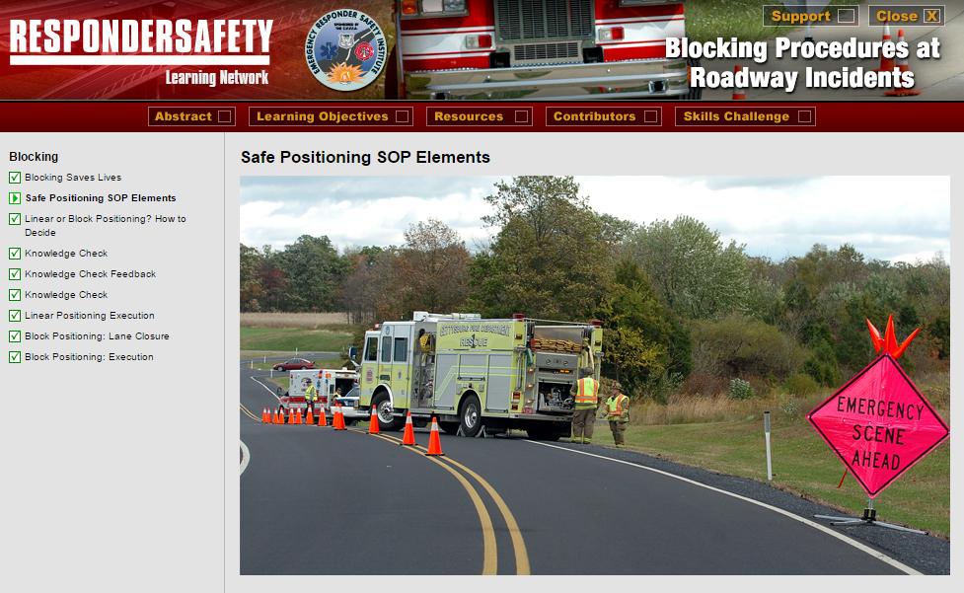
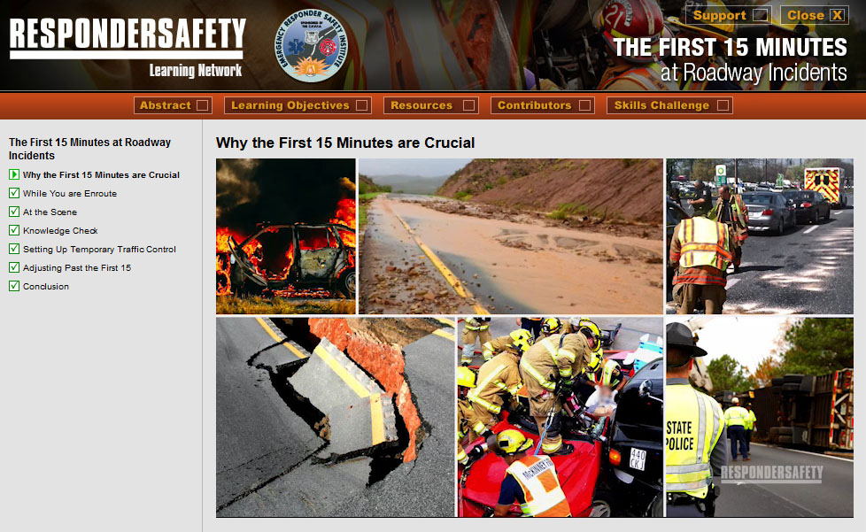
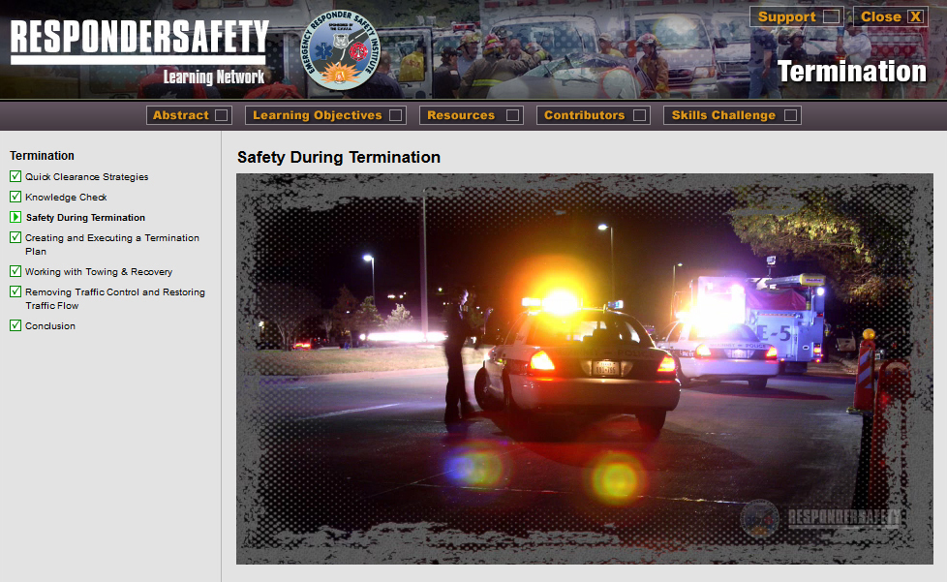
Pre-Class Assignment
Complete the following modules on learning.respondersafety.com
Blocking Procedures at Roadway Incidents
Termination
The First 15 Minutes at Roadway Incidents (optional)
Read our department’s blocking and safe positioning SOP

Slide 4
Learning Objectives
Understand department SOP on advance warning and transition areas
Explain purpose and advantages of blocking
Identify where blocking vehicles are positioned within a TIMA
Properly position a blocking vehicle at a variety of incident scene configurations

Slide 5
NFPA 1091 JPRs
4.2.2 Position a vehicle to provide a TIMA at a traffic incident, given a vehicle and a traffic incident, so that the vehicle is safe-positioned to approaching traffic.
4.2.9 Perform TIMA demobilization functions, given a traffic incident, orders to demobilize, and TTC devices, so that safety and communication among all responders is maintained, all TTC devices are removed, and all resources and personnel are cleared from the scene.

Slide 6
Department Training Requirements
[Instructor to insert correlations to department training rotations]

Slide 7
Introduction

Slide 8
Case Study
[Instructor to insert summary and teaching points from selected case study]

Slide 9
SOP Review
[Instructor to insert key points from the department’s SOP]

Slide 10
SOP Review

Slide 11
Discussion: Blocking Procedures
Always leave enough room between the blocking vehicle and the work area to allow the blocking vehicle to roll forward without hitting equipment or personnel if it is struck.
The significant advantage of an angled block is that it signals to approaching traffic that the emergency vehicle is stopped, parked, and not moving.

Slide 12
Discussion: Blocking Procedures
“Block right”: Position on an angle so the front of the apparatus is aimed to the right in the direction of traffic flow. For fire incidents, the unit is often parked on a block right angle to protect pump operators stationed at the pump panel on the driver side of the engine. If the pump panel is not attended, the rig is often positioned on an angle directing traffic to the open lanes for passing the incident.

Slide 13
Discussion: Blocking Procedures
“Block left”: Position on an angle so the front of the apparatus is aimed to the left in the direction of traffic flow.

Slide 14
Discussion: Blocking Procedures
Factors in determining the direction of the block:
the location of the incident in the roadway
traffic flow in the area
type of incident
road topography and available lanes
weather conditions
visibility at the scene

Slide 15
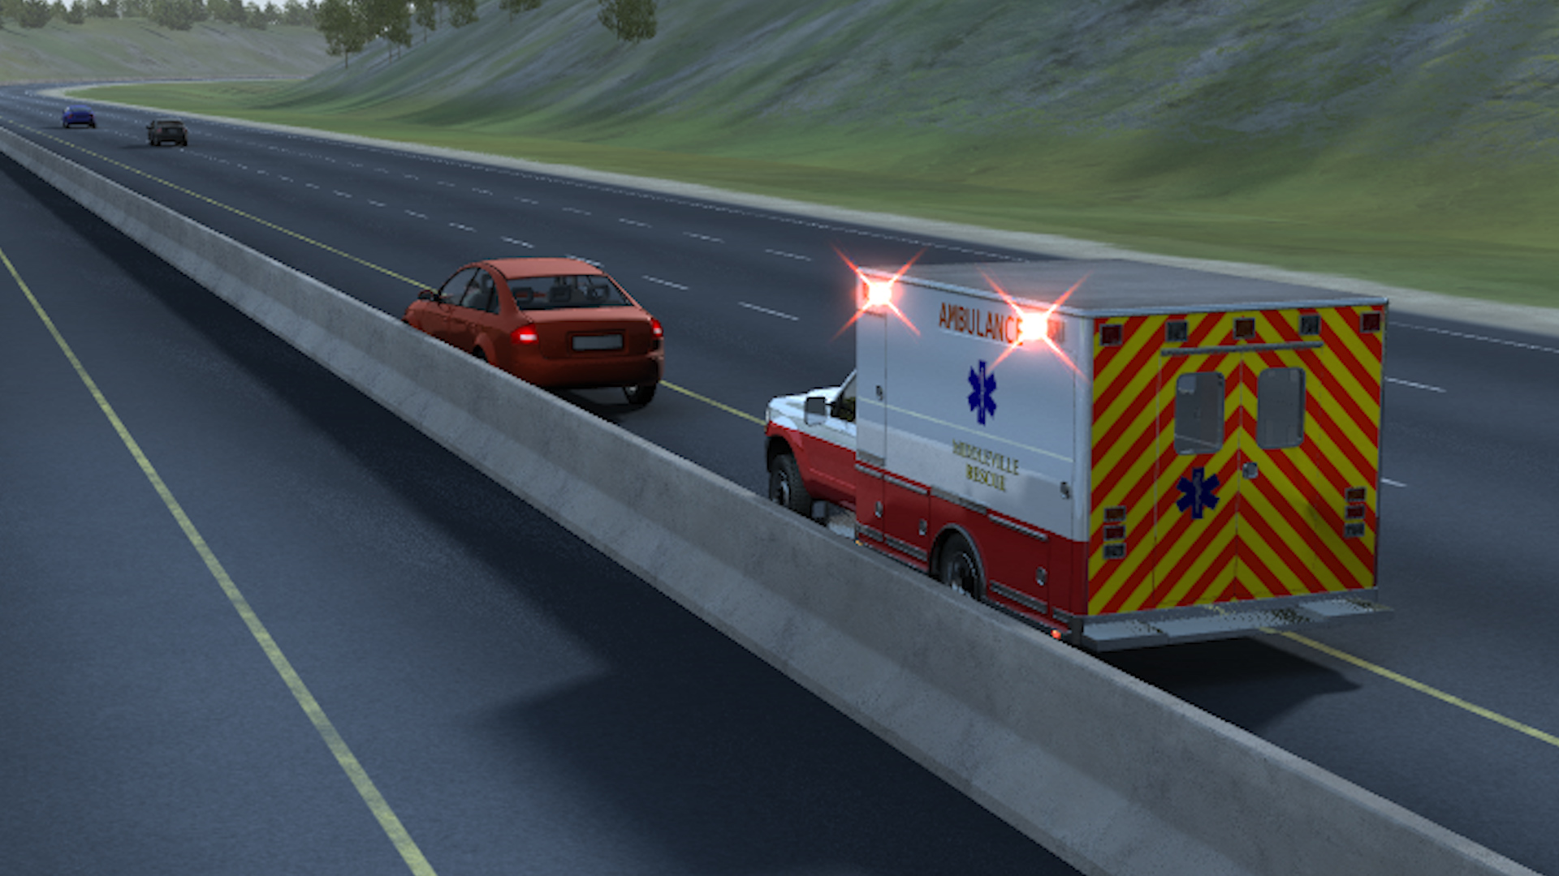
Discussion: Blocking Procedures
When a linear block is appropriate
Linear block: Position the response vehicle in a straight line directly upstream of the first incident vehicle within the same lane.

Slide 16
Discussion: Blocking Procedures
Once a blocking vehicle is parked:
Cut the wheels to their critical wheel angle.
Set the parking brake.
Initiate stationary light shedding procedures according to NFPA standards, department protocol and apparatus capabilities.
Set a wheel chock once the vehicle has been safely exited.
Adjust blocking as the incident changes.

Slide 17
Discussion
Identify gaps between current practice and the SOP.
How do we eliminate those gaps?

Slide 18
Exercise
[Instructor to insert any needed setup information for the chosen tabletop or practical exercise]

Slide 19
Wrap Up
Discuss particular blocking and safe positioning issues pertinent to the department, such as POV parking, coordination with law enforcement vehicle parking, or staging areas for major incidents.

