Slide 2
Administrative Information
Overview & Purpose
Learn/Practice manual traffic control signals
Topics
NFPA 1091
PPE / high visibility apparel
Manual traffic control signals
Manual traffic control equipment

Slide 3
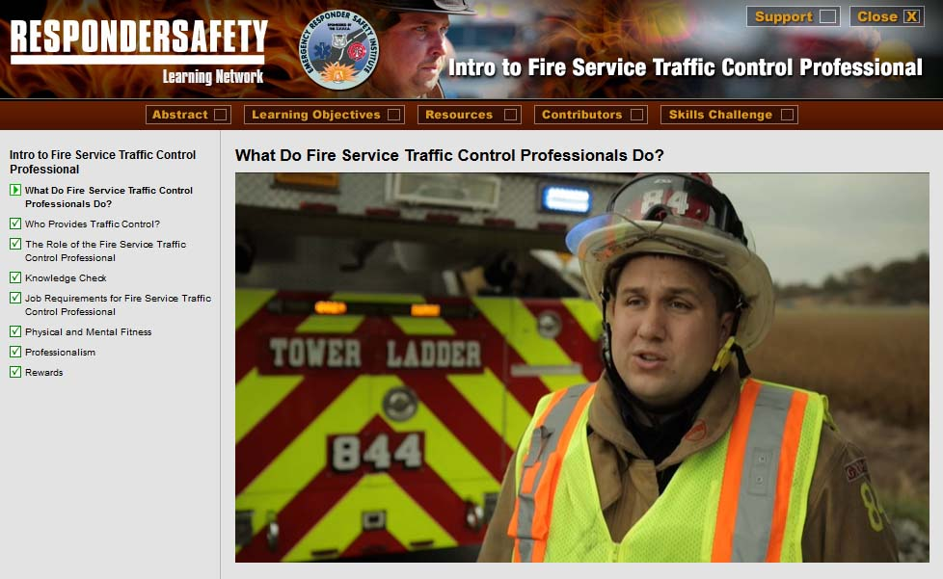
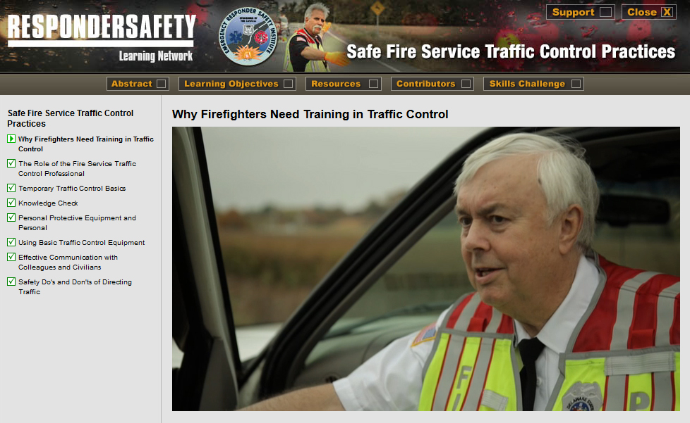
Pre-Class Assignment
Complete the following modules on learning.respondersafety.com
Understanding the New NFPA 1091
Intro to Fire Service Traffic Control Professional
Safe Fire Service Traffic Control Practices
Read our department’s SOPs related to manual traffic control

Slide 4
Learning Objectives
Understand the importance of manual traffic control
Understand the role of the department in providing manual traffic control
Describe the purpose of NFPA 1091 and its relevance to the department’s work
Demonstrate proper manual traffic control signals in accordance with department policy

Slide 5
NFPA 1091 JPRs
4.2.3 Establish a TIMA at a traffic incident
4.2.5 Operate as a member of a team within a TIMA

Slide 6
Department Training Requirements
[Instructor to insert correlations to department training rotations]

Slide 7
Introduction

Slide 8
Case Study
[Instructor to insert summary and teaching points from selected case study]

Slide 9
SOP Review
[Instructor to insert key points from the department’s SOP related to this topic]

Slide 10
SOP Review

Slide 11
Discussion
Situations in which manual traffic control is used
Situations in which manual traffic control is not used
How the determination whether to use manual traffic control is made and who makes it
Identify gaps between current practice and the SOP and how to eliminate those gaps

Slide 12
Exercise
[Instructor to insert any needed setup information for the chosen tabletop or practical exercise]

Slide 13
Wrap Up
How to coordinate traffic control with other agencies present at roadway incidents in our jurisdiction
Under what circumstances the department is tasked with providing traffic control and under what circumstances a different department may provide it
Whether those other departments use the same or different signals and how we might train together to be fluent in each others’ systems

