Slide 2
Administrative Information
Overview & Purpose
Explain the importance of scene control and how to implement basic scene control measures at a scene
Topics
Department SOPs
Dispatch of personnel
Accountability system
Designating staging areas
Managing non-involved persons
Managing news media

Slide 3
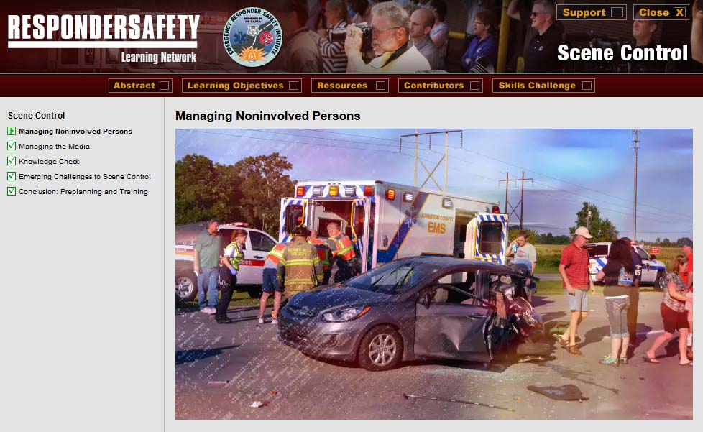
Pre-Class Assignment
Complete the following modules on learning.respondersafety.com
Scene Control
Read our department’s scene control SOP

Slide 4
Learning Objectives
Understand department SOPs on scene control
Describe how personnel are dispatched and accounted for at the scene
Explain why scene control is important
Properly designate staging areas
React appropriately to various situations of encountering non-involved persons at the scene
React appropriately to media presence at the scene

Slide 5
NFPA 1091 JPRs
4.2.6 Manage noninvolved persons found near or within a TIMA

Slide 6
Department Training Requirements
[Instructor to insert correlations to department training rotations]

Slide 7
Introduction

Slide 8
Case Study
[Instructor to insert summary and teaching points from selected case study]

Slide 9
SOP Review
[Instructor to insert key points from the department’s SOP related to this topic]

Slide 10
Discussion
How to handle the following types of noninvolved persons:
Family member or friend who arrives to pick up a victim
Distraught person seeking information on victims
Person attempting to videotape or photograph the incident and the response
A known reporter or photographer from a mainstream media outlet seeking information and a vantage point to cover the incident
A person claiming to be a blogger covering the incident in the public interest
An area resident who wants to watch because they are curious about the response
An unmanned drone taking aerial footage of the scene

Slide 11
Exercise
[Instructor to insert any needed setup information for the chosen tabletop or practical exercise]

Slide 12
Wrap Up
Recap the most important points of the department’s scene control SOP as related to the training experience

