Slide 2
Administrative Information
Overview & Purpose
Learn/Practice how to set up a traffic incident management area (TIMA)
Topics
NFPA 1091
MUTCD and/or any state supplement that applies
PPE / high visibility apparel
Traffic Incident Management Area (TIMA)

Slide 3
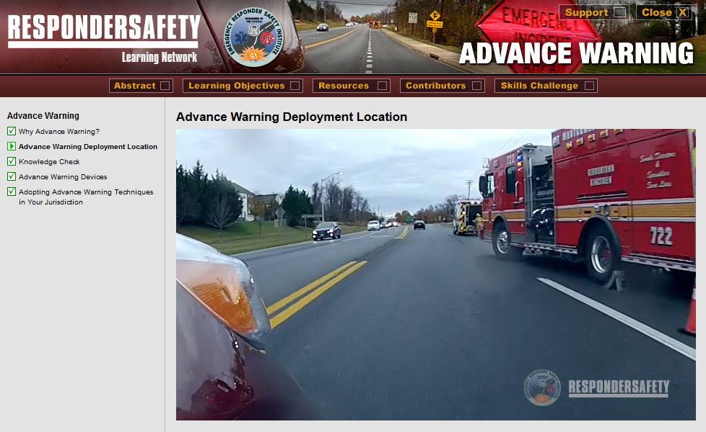
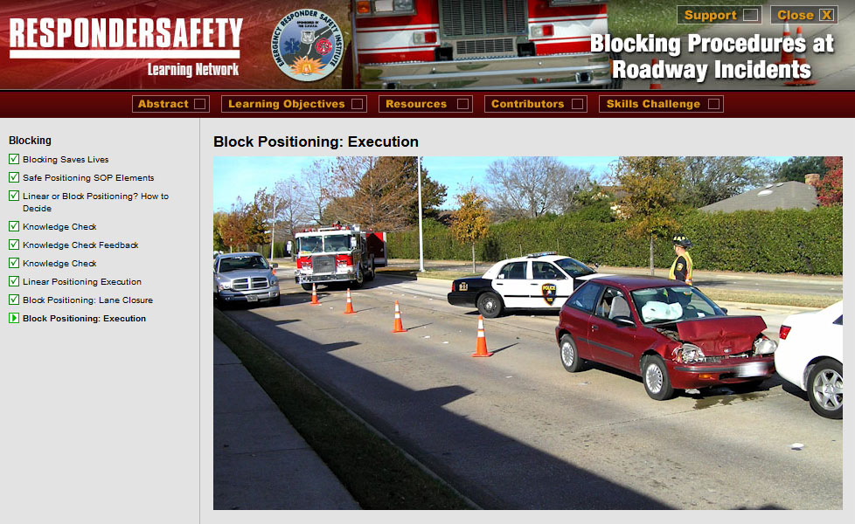
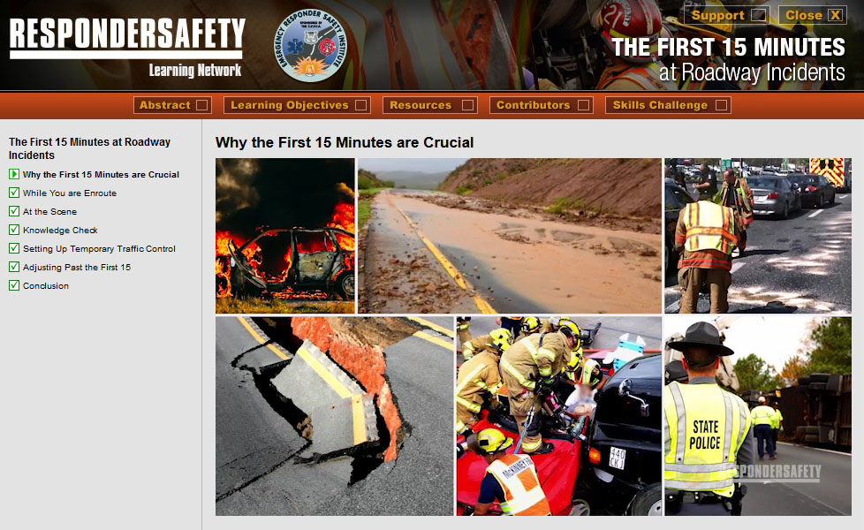
Pre-Class Assignment
Complete the following modules on learning.respondersafety.com
Understanding the New NFPA 1091
Advance Warning
Blocking Procedures at Roadway Incidents
The First 15 Minutes
Termination
Traffic Incident Management on Rural Roads
Manual on Uniform Traffic Control Devices (MUTCD)

Slide 4
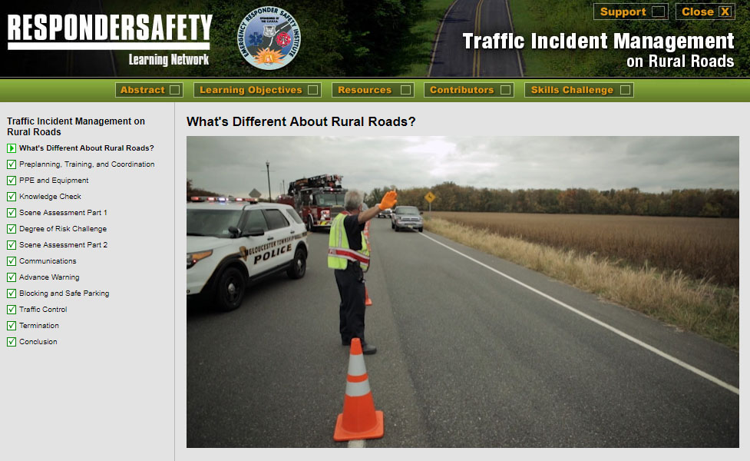
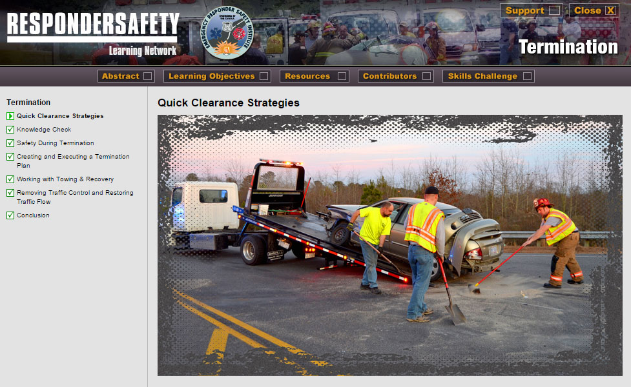
Pre-Class Assignment
Read our department’s SOPs related to traffic incident management

Slide 5
Learning Objectives
Understand the importance of traffic control management
Understand the role of your department in providing traffic control
Describe the purpose of NFPA 1091 and its relevance to the department’s work
Demonstrate proper use of PPE at a roadway incident scene
Demonstrate how to properly establish and demobilize a TIMA

Slide 6
NFPA 1091 JPRs
4.2.2 Position a vehicle to establish a TIMA at a traffic incident
4.2.3 Establish a TIMA at a traffic incident
4.2.4 Establish advance warning for the traffic incident
4.2.5 Operate as a member of a team within a TIMA
4.2.7 Monitor and adjust the TTC measures at a traffic incident
4.2.8 Adapt the TIMA in response to a hazard
4.2.9 Perform TIMA demobilization functions

Slide 7
Department Training Requirements
[Instructor to insert correlations to department training rotations]

Slide 8
Introduction

Slide 9
Case Study
[Instructor to insert summary and teaching points from selected case study]

Slide 10
SOP Review
[Instructor to insert key points from the department’s SOP related to establishing a TIMA]

Slide 11
Discussion
Notes:
Distribute TIMA diagram and refresh students on the purpose of a TIMA and its anatomy. A TIMA has four areas:
Advance Warning Area, where signage, arrow boards, message boards, an emergency vehicle and/or other devices warn oncoming traffic that an emergency scene is ahead.
Transition Area, where channelizing devices like cones, close lanes of traffic and notify oncoming traffic how to navigate around the incident.
Activity Area, where the first element is a large, heavy emergency vehicle blocking the incident space from intrusion by oncoming vehicles and the remainder incident space is where the incident is worked.
Termination Area, where channelizing devices are used to terminate the TIMA and reopen closed lanes of traffic.
Discuss with the group how traffic control assignments are made.

Slide 12
Exercise
[Instructor to insert any needed setup information for the chosen tabletop or practical exercise]

Slide 13
Wrap Up
[Instructor to insert teaching points based on department’s procedures for coordinating TIMA setup with other agencies]

